Slide 1
FCS School
Improvement Plans
2024-2025

Slide 2
In September, principals met with district leadership to set academic goals based on data from the 2024-2025 school year.
NC Check-ins are administered for reading, math, and science for grades 3-8, Biology, Math I, Math III, and English II. These data points are combined with teacher-created and common formative assessments to inform and make instructional modifications to address student needs.
Data meetings are scheduled with principals once the data from the Check-ins is received in order to review school strengths, areas of opportunity, and next steps.
Each quarter, grade span and content-specific meetings are held for grades K-8, Math I, Math III, Biology, and English II. When available, data is shared with teachers and trends across the district are identified and addressed.
Instructional coaches meet monthly to discuss teaching and learning trends across the district, plan for systemwide professional development needs and receive updates for dissemination to teachers.
All middle schools are engaged in Learning Focused, a professional development series focused on instructional best practices and meaningful student engagement.
School Improvement Planning Process

Slide 3
A web-based tool that guides a school leadership team in charting its improvement and managing the continuous improvement process.
Benefits:
TEAM process
State accessibility to real time work
Interactive, online coaching feature
Electronic submissions
Indicators of effective practice
Research support
What is NCStar?

Slide 4
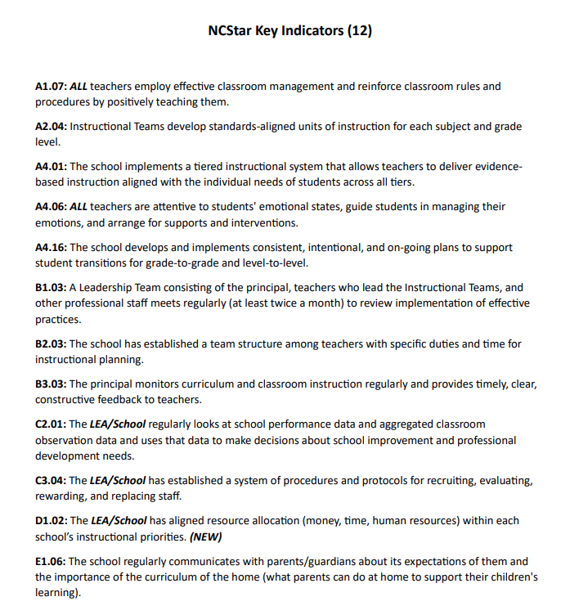
NCStar
Key
Indicators

Slide 5
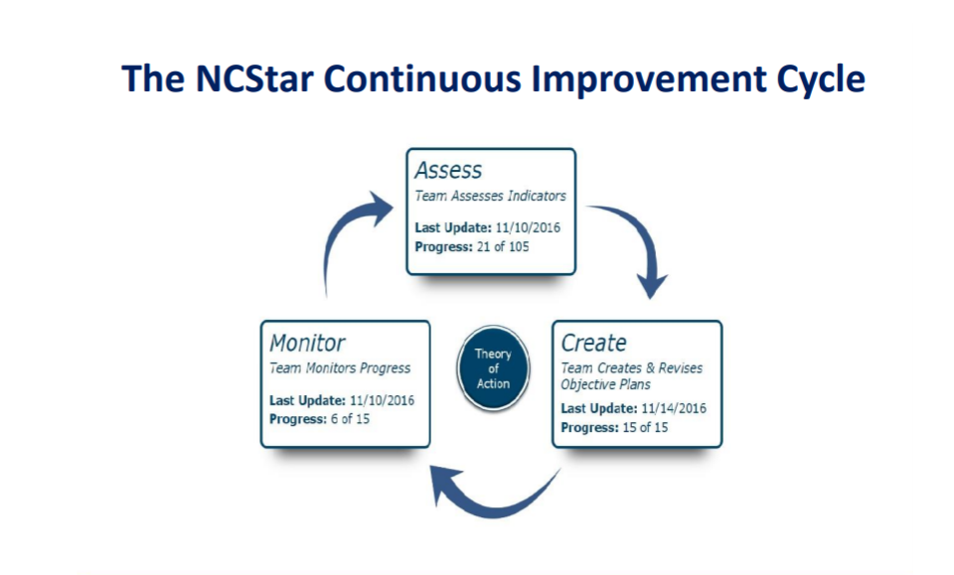

Slide 6
Comprehensive plan for each school. This includes assessment of all twelve NC Star indicators with 3-5 indicators chosen as priorities for the 2024-2025 school year.
Comprehensive School Improvement Plan for each school (resembles more of the “traditional” school improvement plan; includes EOG/EOC specific goals)
Items for Review

Slide 7
Bunn Elementary
NCStar Plan
Comprehensive SIP
Edward Best Elementary
NCStar Plan
Comprehensive SIP
Laurel Mill Elementary
NCStar Plan
Comprehensive SIP
Long Mill Elementary
NCStar Plan
Comprehensive SIP
Royal Elementary
NCStar Plan
Comprehensive SIP
Youngsville Elementary
NCStar Plan
Comprehensive SIP
Elementary
SIP Documents

Slide 8
Bunn High
NCStar Plan
Comprehensive SIP
Early College High
NCStar Plan
Comprehensive SIP
Franklinton High
NCStar Plan
Comprehensive SIP
Louisburg Magnet High
NCStar Plan
Comprehensive SIP
High School
SIP Documents

Slide 9
Presented at the October 14th Board of Education meeting
Posted for public comment since October meeting
Once approved by the BOE, must be submitted to DPI within 5 days
Link to LP Presentation
SIPs for Low-Performing Schools

Slide 10
Any questions?

Slide 11
Request:
Recommend approval of the school improvement plans for all Franklin County Schools for the 2024-2025 school year.

