Slide 1



Blueprint 2030
Strategic Plan
Franklin County Schools
December 2024 Board of Education Meeting

Slide 2


Slide 3

FRANKLIN COUNTY SCHOOLS
VISION AND MISSION
VISION
Building a stronger community one life-long learner at a time.
MISSION
Franklin County Schools will cultivate a dynamic learning environment focused on success beyond the classroom; preparing, inspiring and illuminating the path so that all students will reach their full potential.

Slide 4
FRANKLIN COUNTY SCHOOLS
Core Values
Community
Diversity
Respect
Integrity
Excellence

Slide 5


Slide 6
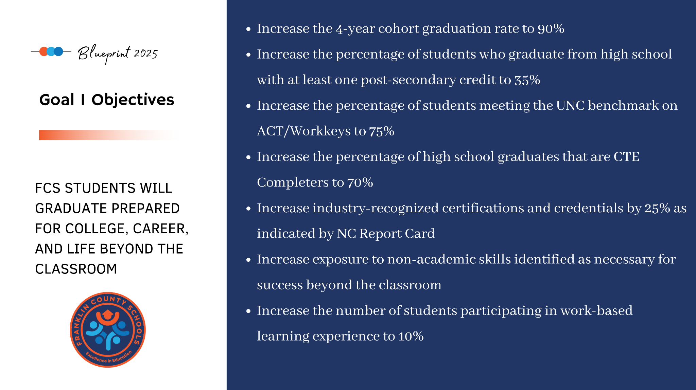

Slide 7
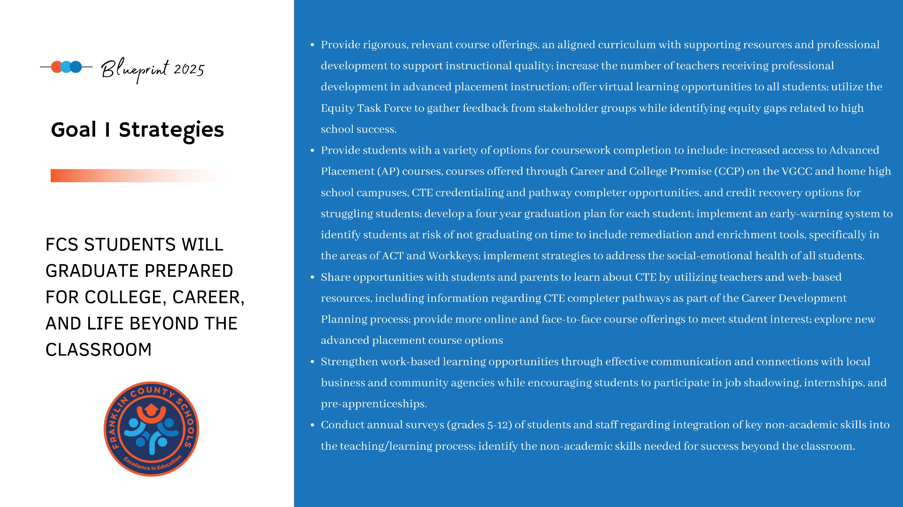

Slide 8
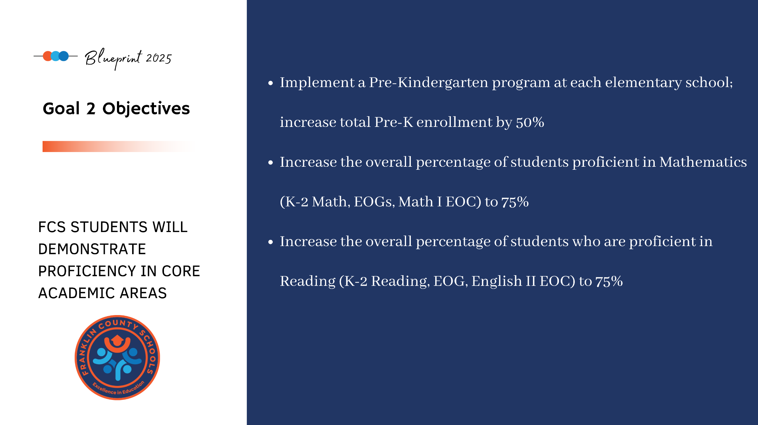

Slide 9
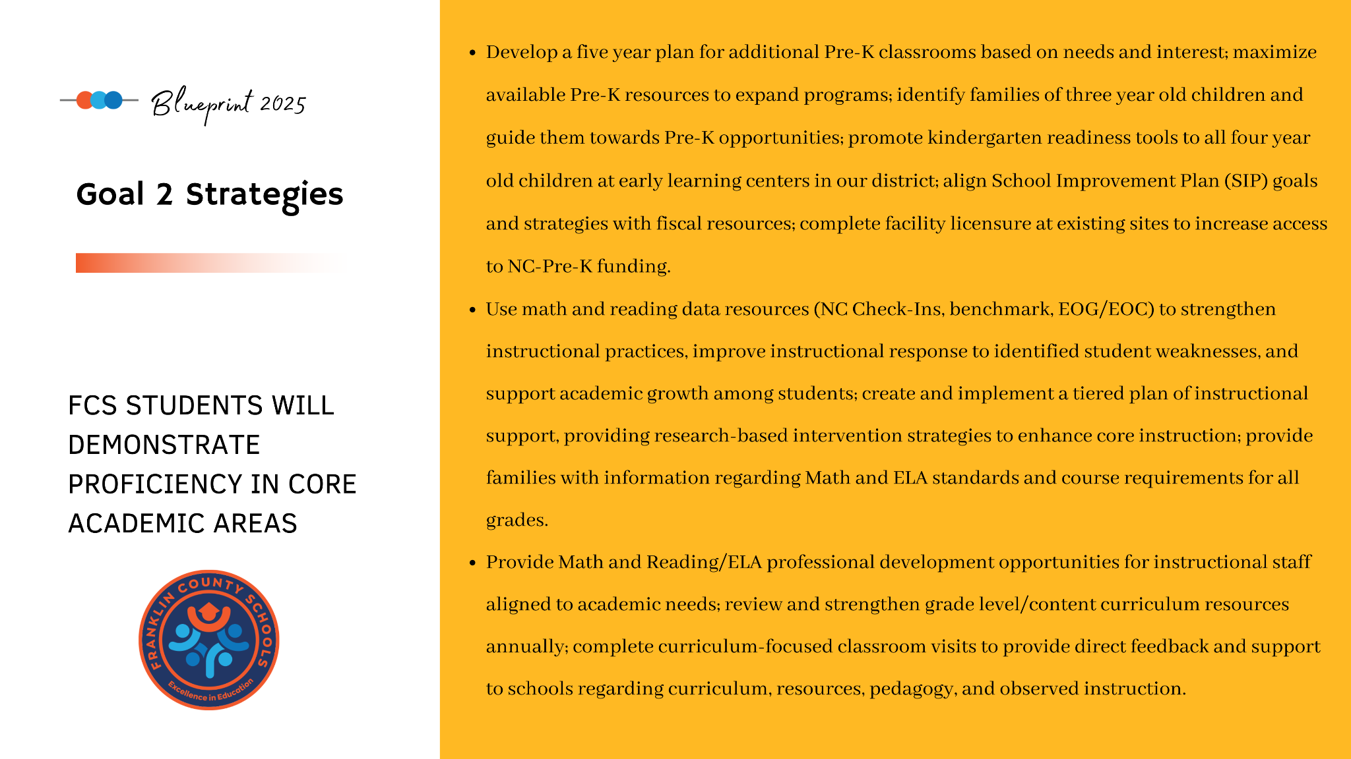

Slide 10
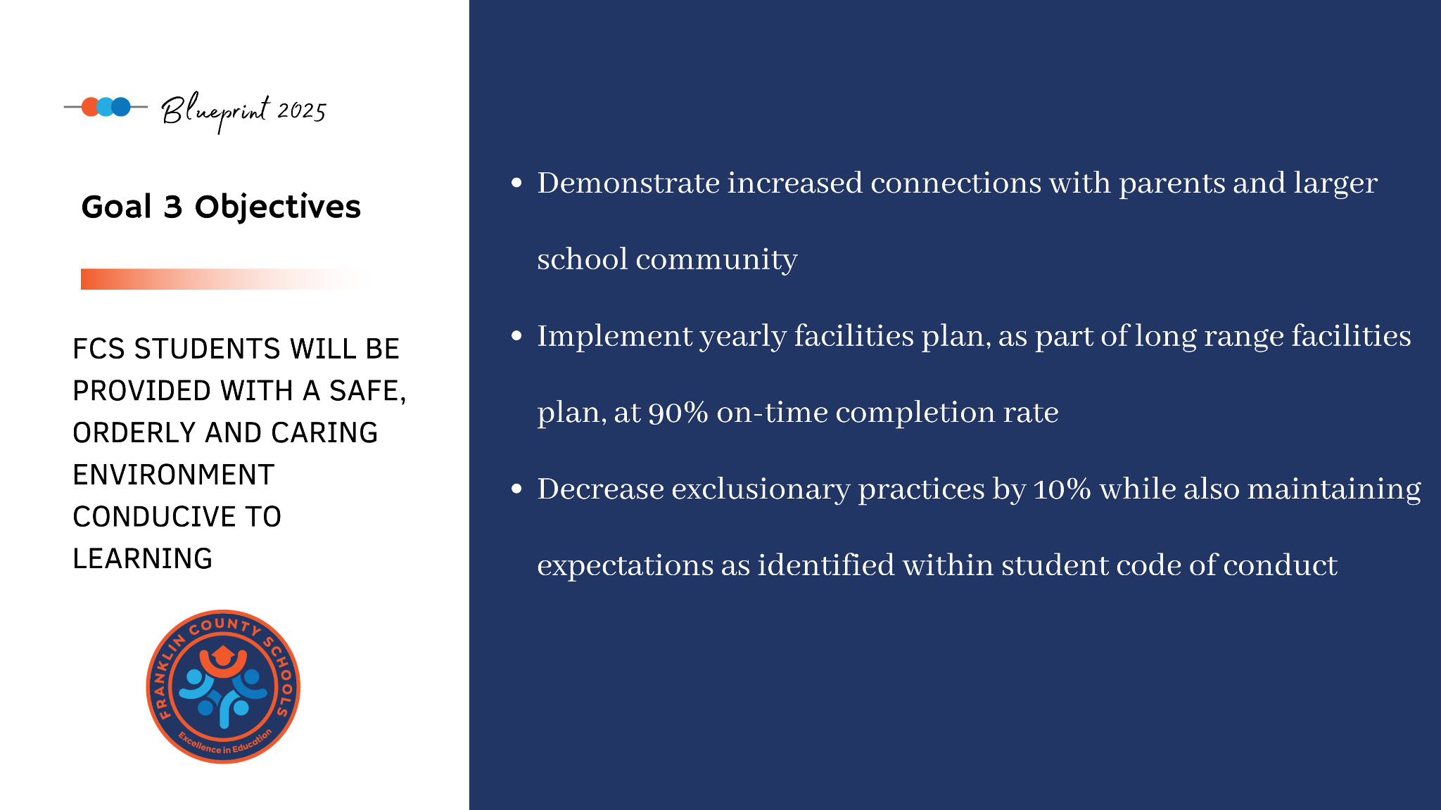

Slide 11
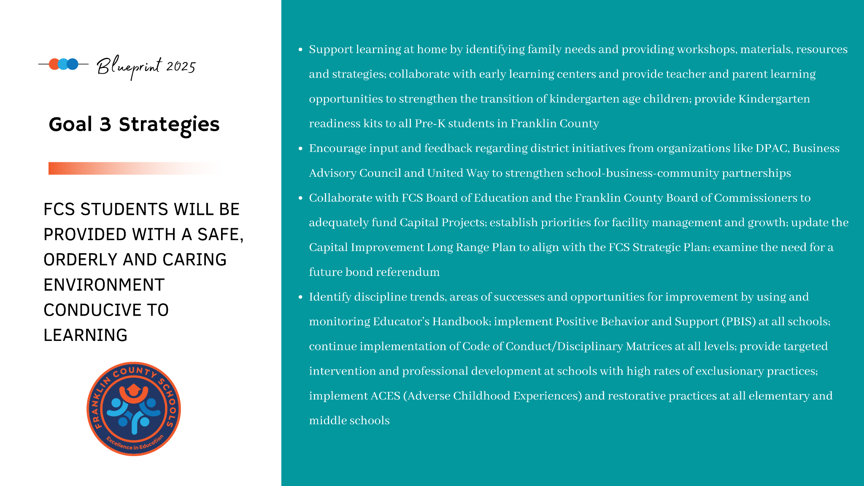

Slide 12
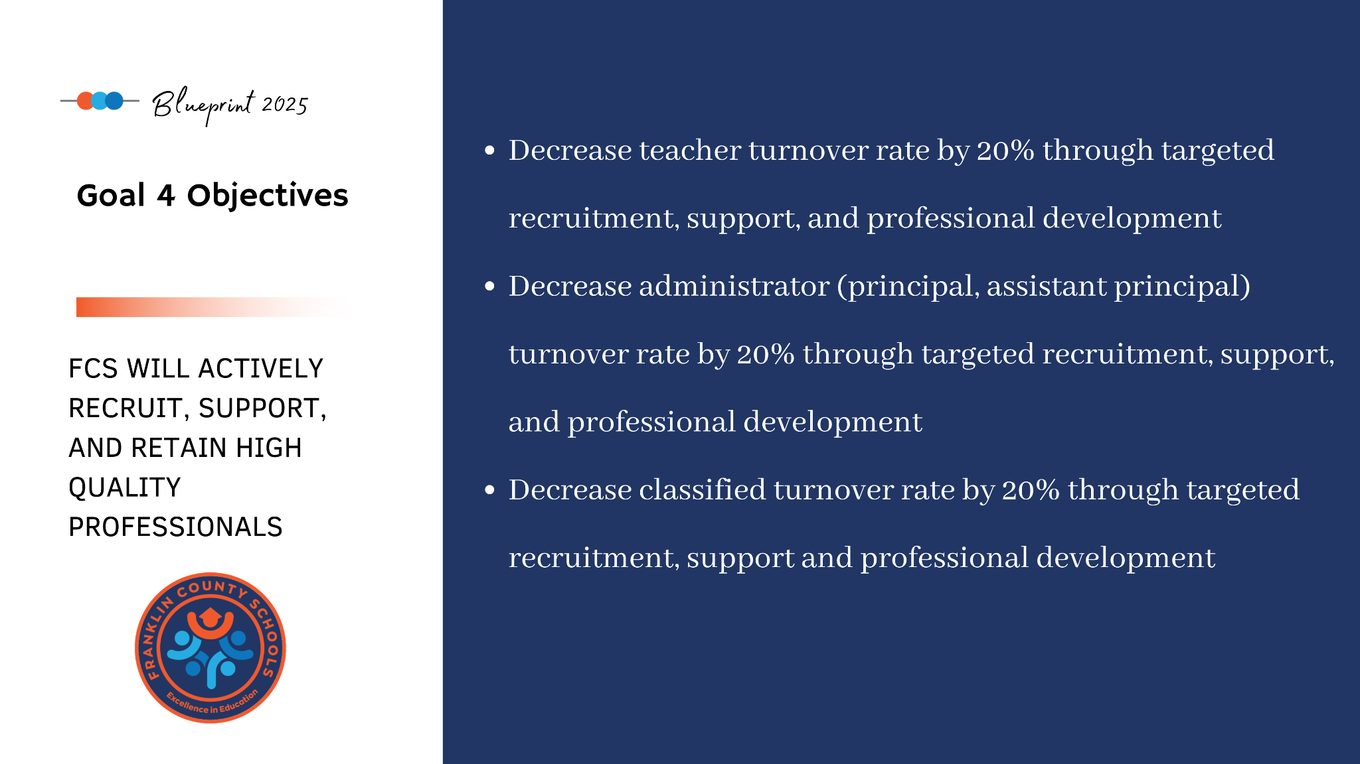

Slide 14
Our Plan for the New Strategic Plan, Blueprint 2030:
Gather feedback from a diverse group of key stakeholders, through surveys and town halls, on priorities for the future of our schools
The Strategic Planning Committee (SPC) will utilize feedback to:
  Revisit and modify existing vision, mission and belief statements
  Revisit and modify existing strategic plan goals, as well as strategies and outcomes. The committee may decide to replace, add or delete goals as needed to reflect the changing needs of our school community.
Notes:
Tonight, you had the opportunity to see our top ten themes from the data collected. You had the chance to vote on your top three. In just a few minutes, you will have the opportunity to discuss these as a table group and then share out. We will take this feedback to begin phase 2 of our planning process.

Slide 15





New Process
Gather greater stakeholder input
Stakeholder Surveys
Town Halls
SPC 2030 Collaboration
Utilize surveys to gather feedback on strengths and areas for improvement, as well as priorities
Utilize a “Town Hall” format for each zone to host conversations with stakeholders and to gather additional feedback
Incorporate data gathered through surveys and Town Hall meetings to develop a strategic plan that is reflective of the priorities of our larger community

Slide 16


Stakeholder Survey
for Blueprint 2030 Process

Slide 17
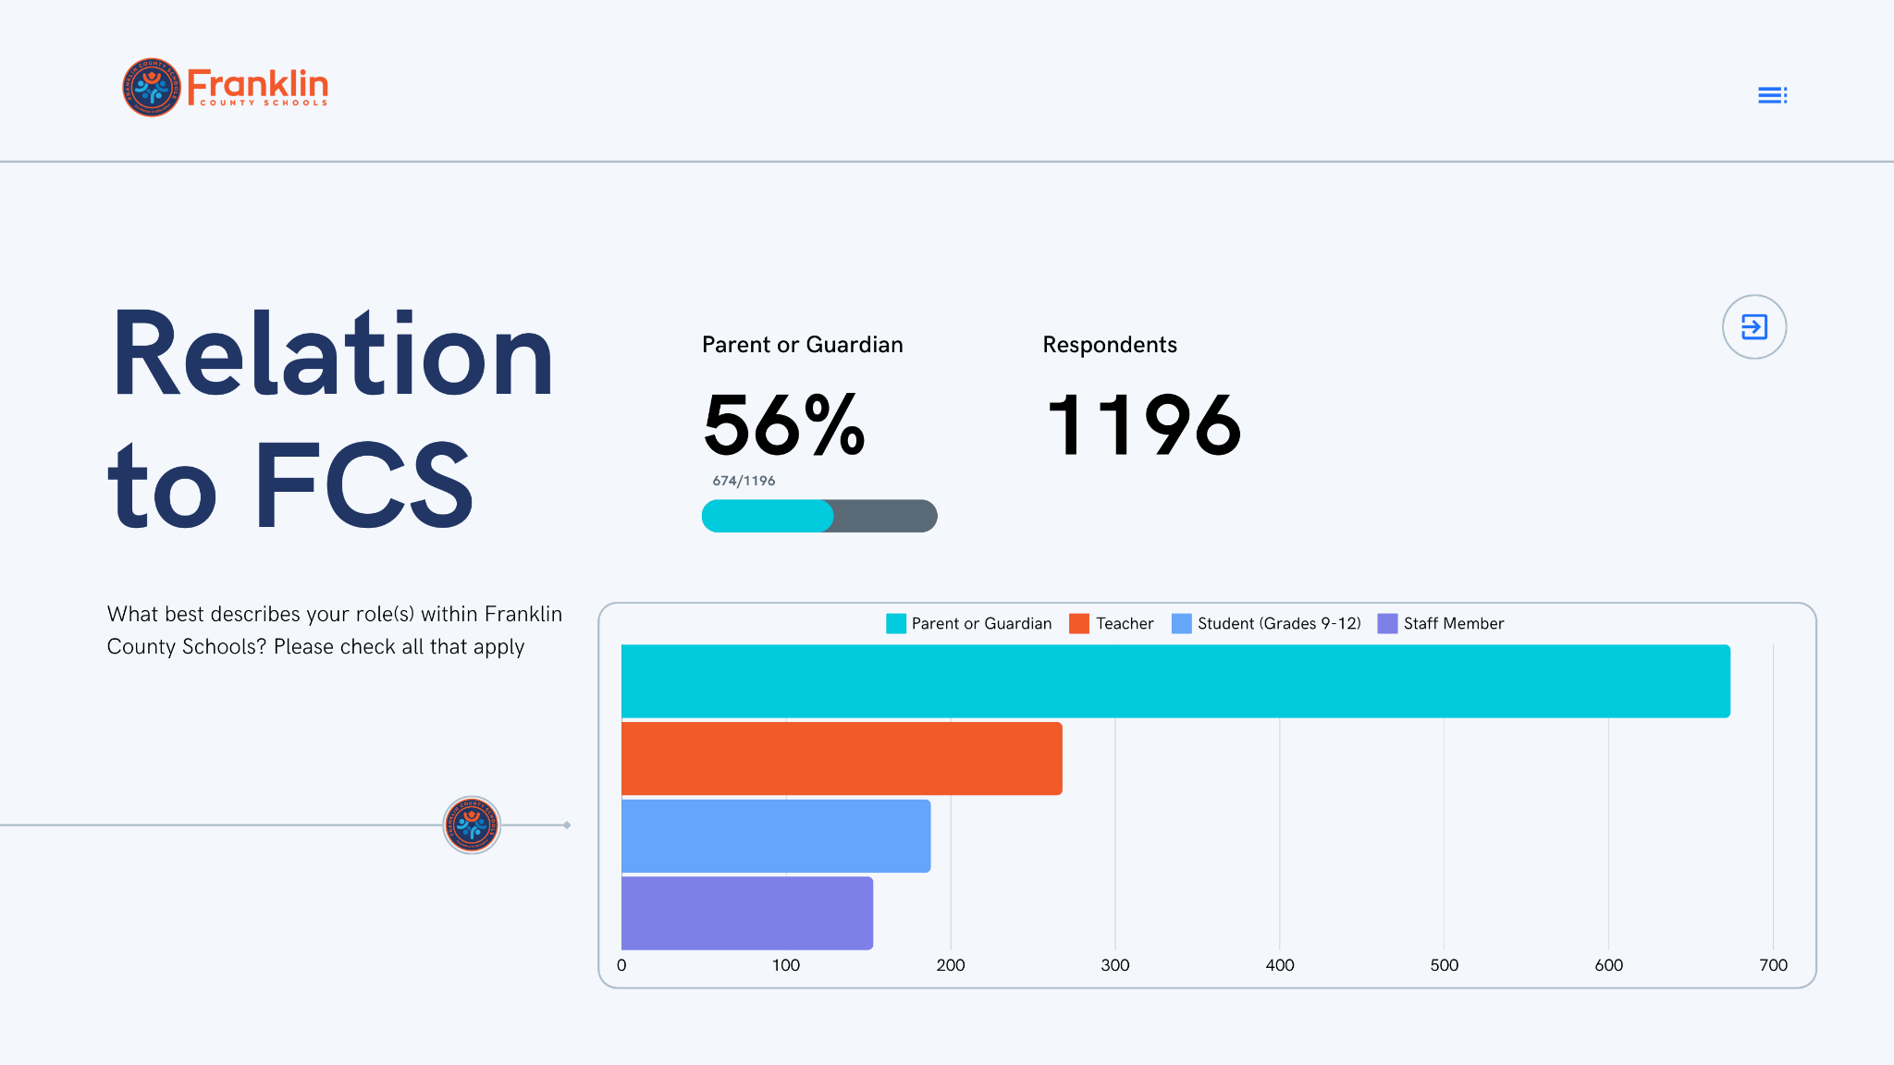
INSERT RESULTS HERE (McIntosh)

Slide 18
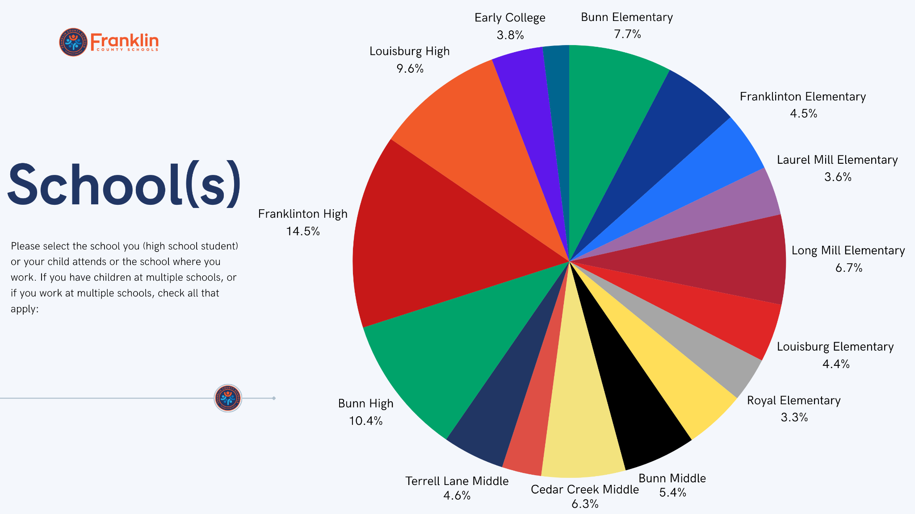

Slide 19
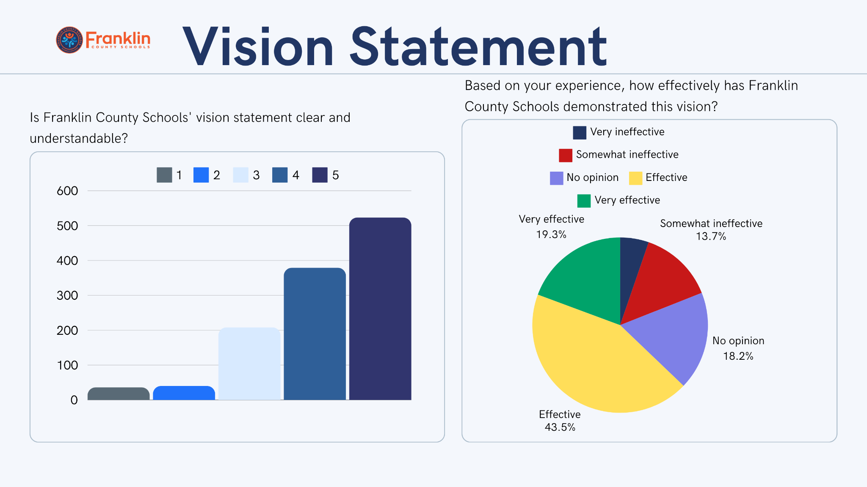

Slide 20
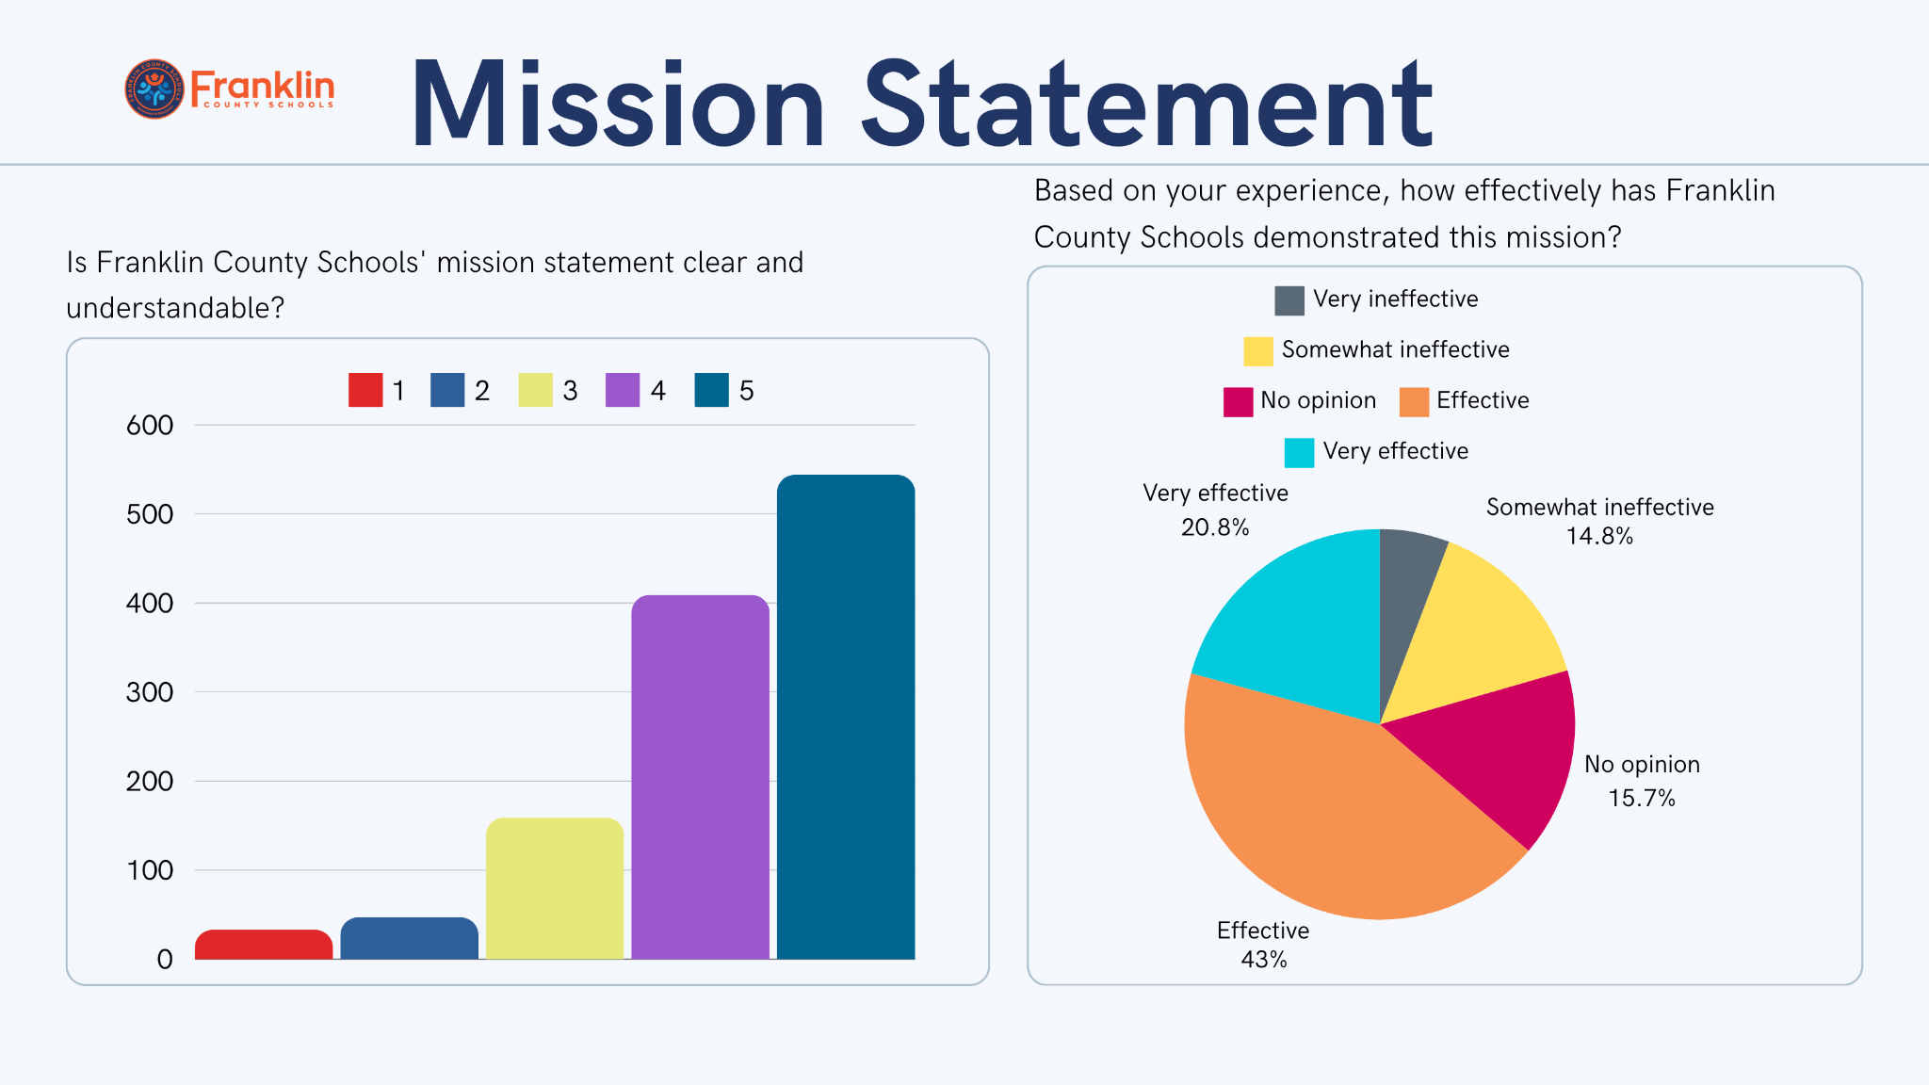

Slide 21
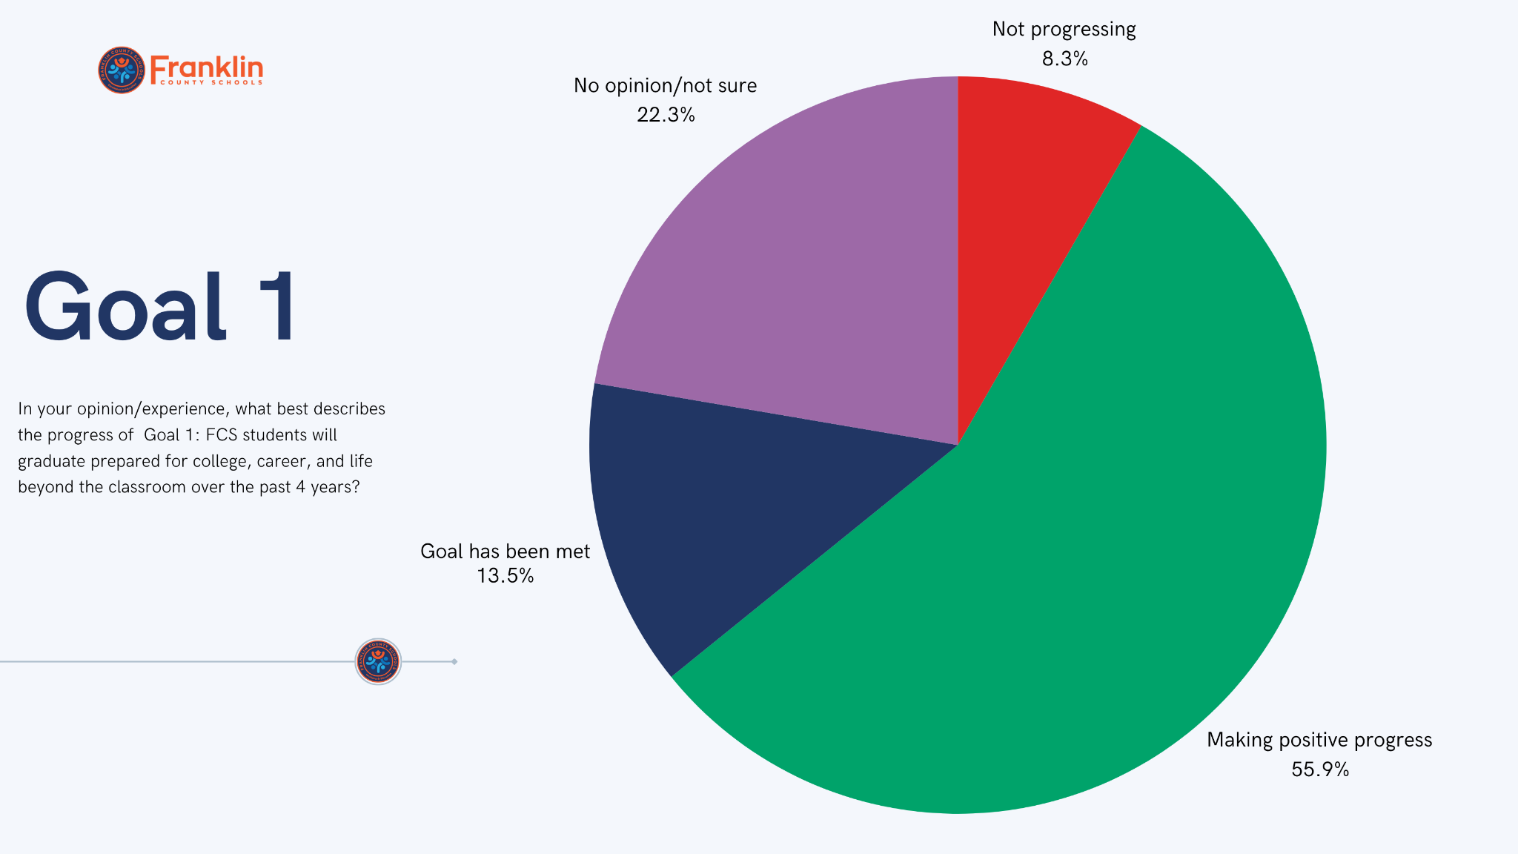

Slide 22
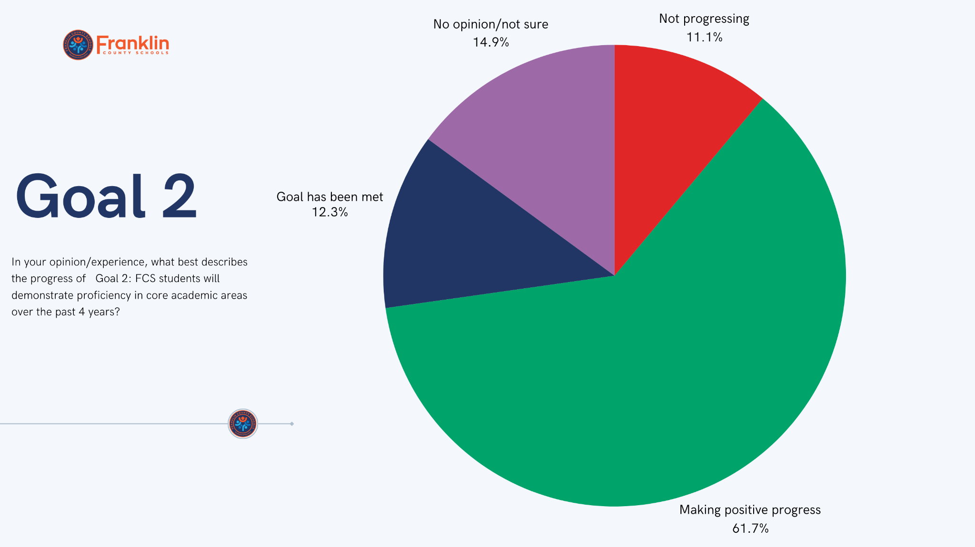

Slide 23
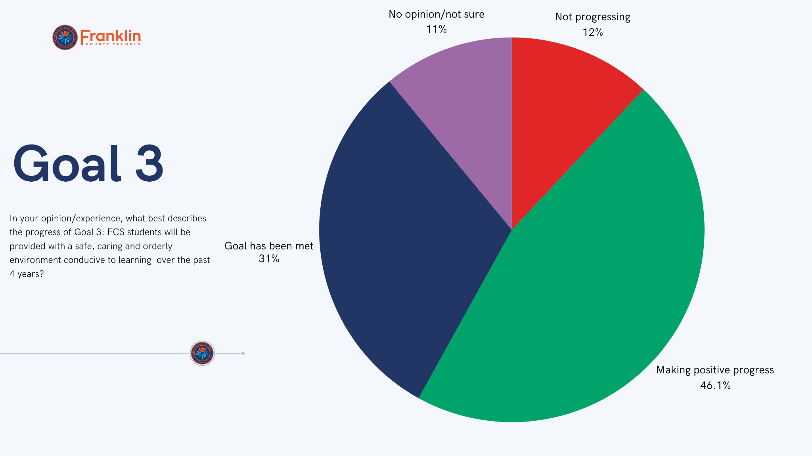

Slide 24
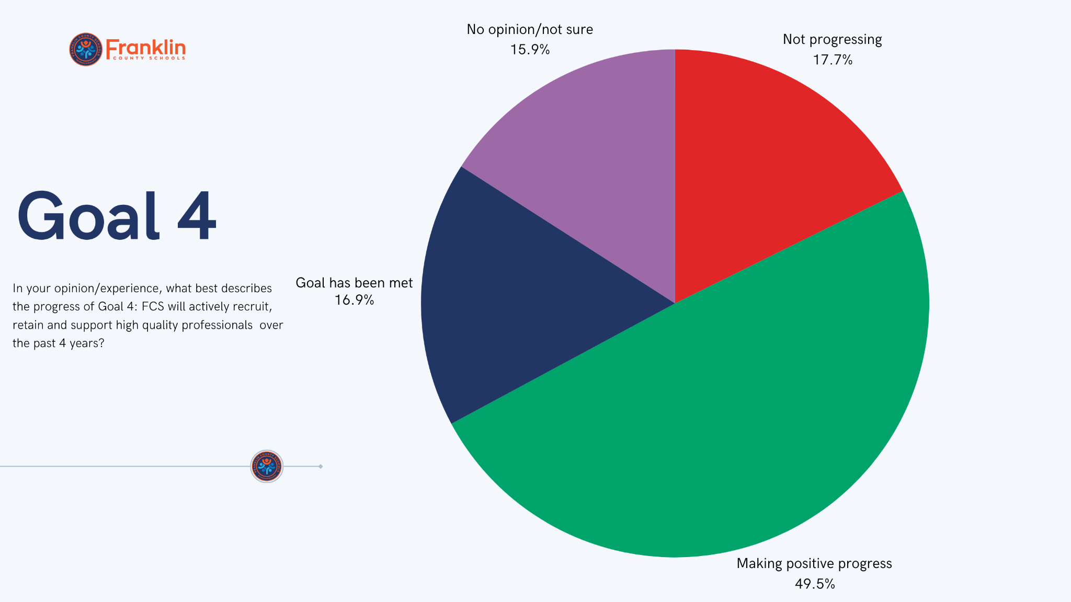

Slide 25
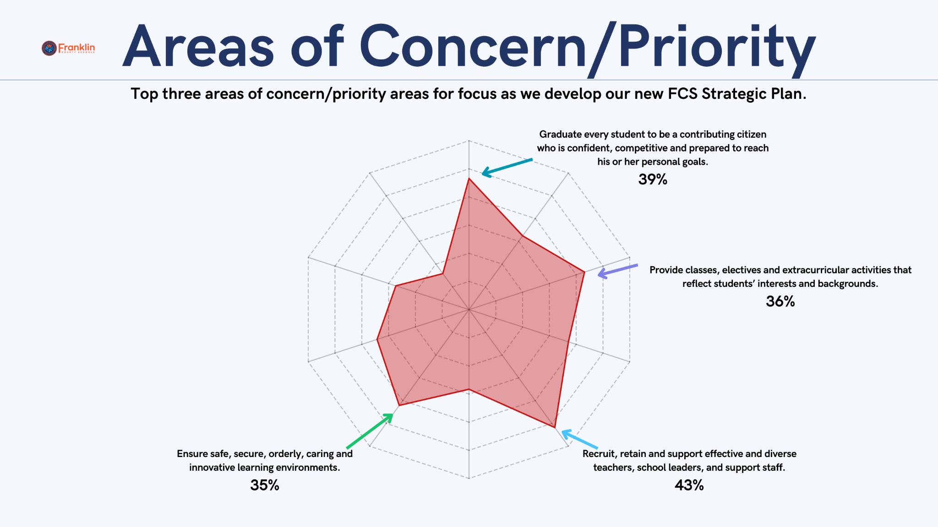

Slide 26
Table Discussion:
What does the data tell us about the strengths of our current Strategic Plan and the work of our district?
What does the data tell us about the weaknesses of our current Strategic Plan and the work of our district?
What is missing from this data? In other words, what does the data not tell us that we need to be considering as we develop a new Strategic Plan?

Slide 27
Town Hall Meetings
for Blueprint 2030 Process

Slide 28

Town Hall Meetings
Town Hall Presentation

Slide 29

Send out surveys for feedback: staff, parents, students (Oct. 21-Nov. 1)
October 2024
November 2024
Convene Strategic Planning Committee (SPC 2030) to review process, survey questions findings, and agendas for Town Halls
Host Franklin County Schools Town Hall Meetings zonally at each High School to gather feedback
January- February 2025
Convene SPC 2030 for work session to review data gathered through surveys and Town Halls and prioritize/begin to develop goals
March 2025
Update Board of Education
Convene SPC 2030 to finalize Strategic Plan Draft for BOE consideration
April 2025
Present Blueprint 2030 to Franklin County Board of Education for approval
May 2025
Update Board of Education
TIMELINE
for Blueprint 2030 Process

Slide 30
Questions?

