Slide 1
ESSER Contract Renewal: I-Ready
September 11, 2023
Notes:
Good Evening Madam Chair, board members, Dr. Schuhler, and those in attendance this evening.
Tonight, we are going to present you with a compilation of upcoming contracts for consideration as well as a couple ESSER Fund Updates.

Slide 2
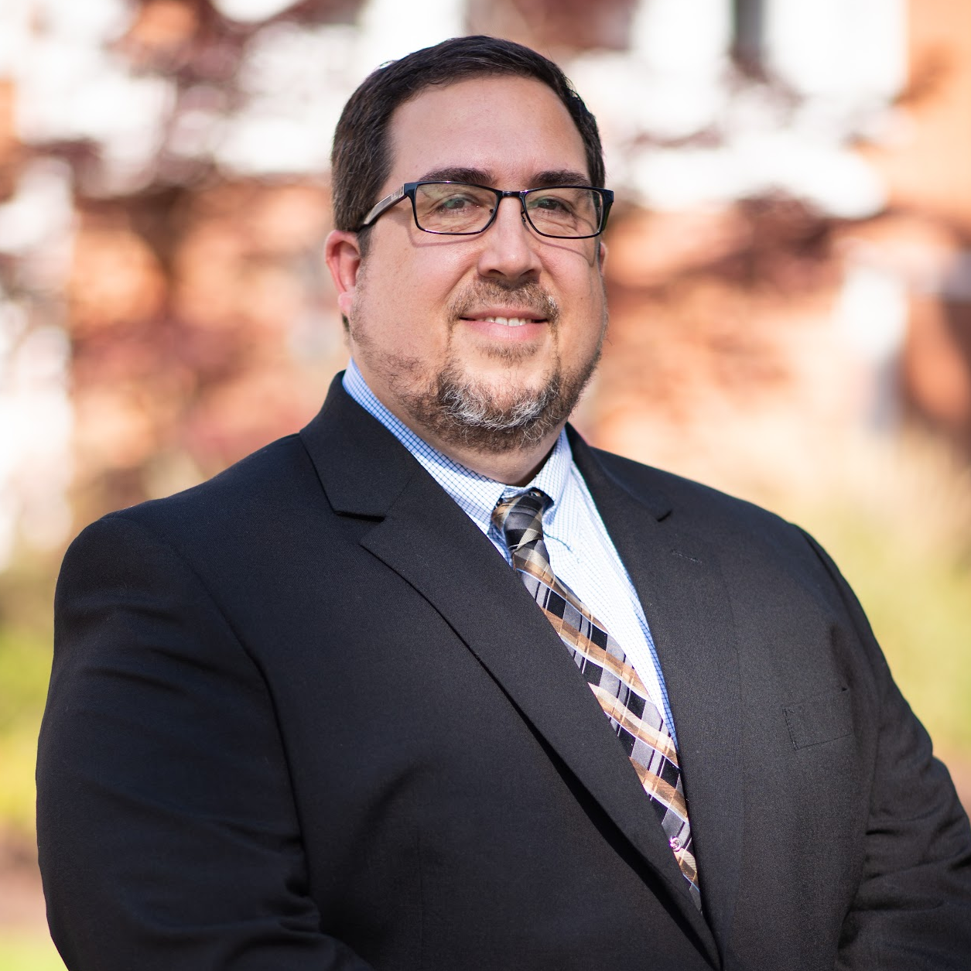
Presenter:
Dr. Geoffrey Hawthorne
Executive Director of Elementary Education & Federal Programs
Notes:
Dr. Parker and I will again be collaborating as we cover these topics as the financial and programmatic elements overlap quite a bit.

Slide 3
i-Ready Contract
2023-24 District Quote: $249,944.24
i-Ready Reading is an intuitive supplemental tool used by students in grades 4th-8th
i-Ready Math is an intuitive supplemental tool used by students in grades K-8
Diagnostics are given 3 times a year to establish learning pathways for each student
The i-Ready Teacher Toolkit provides standards aligned lessons that guide teacher instruction and intervention
i-Ready is designed to support individualized learning (called pathways) that target specific skills students need support with (Goal: is to successfully complete two lessons per week (70% or higher), which should be equal to 45 min
Data from i-Ready informs instructional decisions and is a state recognized data source to identify students for summer learning interventions
i-Ready is standards aligned and research based
2021-22 & 2022-23 Impact Data Indicates Positive Results
Notes:
The first topic we’d like to cover is the renewal of this years i-Ready contract. Back in April, i-Ready information was covered in a larger curriculum presentation, but I wanted to place a few key features of i-Ready here again for your review. Additionally, you will see the i-Ready renewal quote listed near the top of the slide.

Slide 4
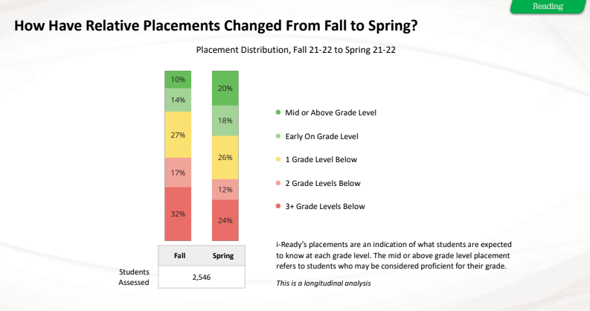
21-22 Data

Slide 5
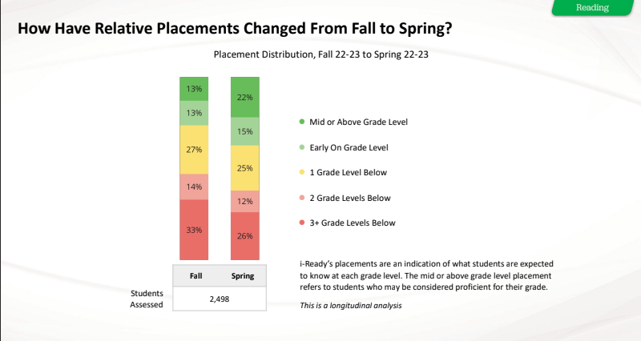
Recent Data

Slide 6
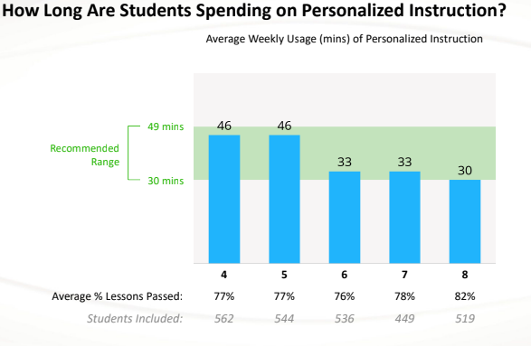
Recent Reading Data

Slide 7
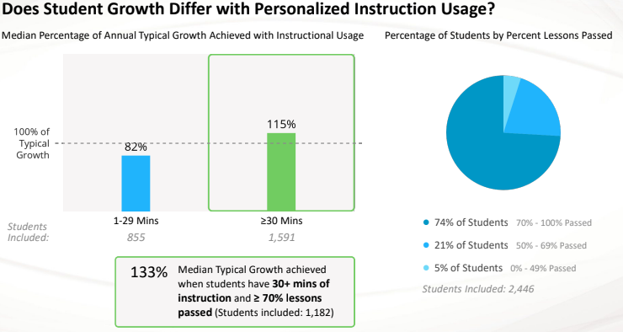
Recent Reading Data

Slide 8
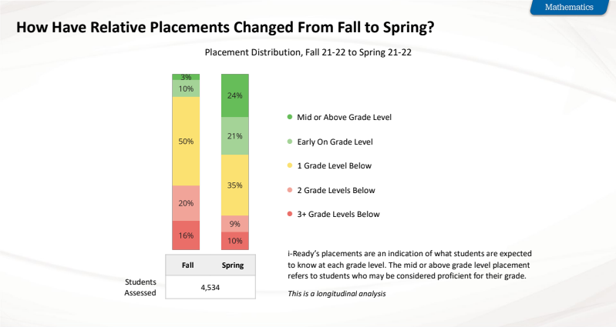
21-22 Data

Slide 9
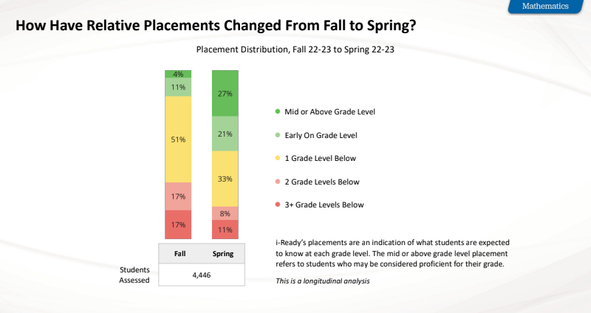
Recent Data

Slide 10
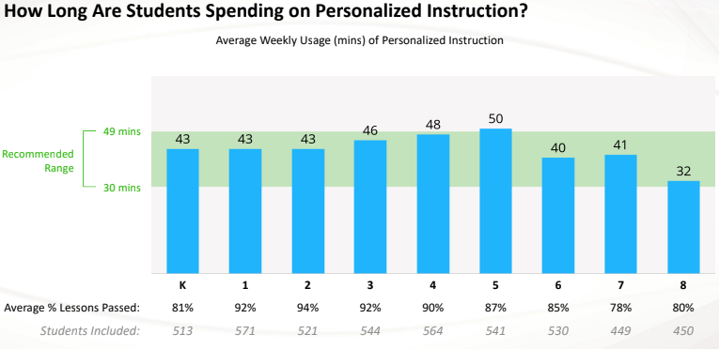
Recent Math Data

Slide 11
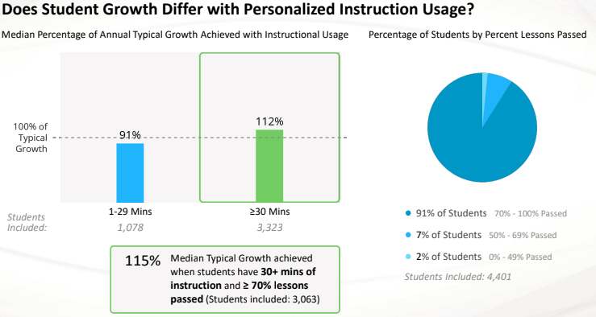
Recent Math Data

Slide 12
Seeking BOE Approval:
I am seeking board approval for our FCS 2023-2024 i-Ready Renewal Contract.

