Slide 1

Current Expense
&
Capital Outlay Budget
2025 - 2026
Presentation to Franklin County Board of Education
April 14, 2025
Notes:
Updated 4-8-25

Slide 2

2025 - 2026
SUPPORT
FOR OUR SCHOOLS
Total Request
$34,715,855 **
**All details shared are based on current information made available and is subject to change**
Notes:
Includes totals for Capital Outlay $4,174,043 ($2,477,856/recurring and $1,696,187/projects), Local Current Operational Support $21,947,599 for FCS (72%) and $8,594,213 for Charters (28%) (Calculations based on PPA share of enrollment projections 11,079 students (7,927 FCS & 3,152 Charters) The enrollment projections for FCS includes 133 PreK students. The enrollment for charters includes 98 virtual charter enrollments
No increase to local current expense, keeping request neutral for 2025-26. Increase of $2,283,432 in capital funding in comparison to prior year’s funding level. QC UPDATED 4-8-25

Slide 3
Our two identified priority areas impact two different budget categories:
Funding Priority #1 | Funding Source
Maintaining Current Expense Budget at the 2024-25 Funding Level | “Local Current Expense” Budget
Adequately Address Short Term and Long Term Facilities Needs | “Capital Outlay” Budget
We will look at each of these priorities within the context of the impacted budget area, along with other budgetary impacts that fall within these areas.
Notes:
QC UPDATED 4-8-25

Slide 4
Current Expense

Slide 5
Per Pupil Allocation
“Current Expense” is a local budget that is funded from the County as “per pupil allotment” (PPA). Every student in the County that is served by either Franklin County Schools or charter schools receives a PPA. These funds are filtered through Franklin County Schools to charter schools serving Franklin County residents.
Notes:
No Updates Required

Slide 6
Local Current Expense Budget at a Glance
State, Federal and some granted funds support some salaries, benefits and operational needs, but local funding is required to supplement many of these areas of need.
Categorical areas of support from local funding include the following and much more:
  Retention and Signing Bonuses
  Local Supplements for Teachers and Administrators
  Central Office Support Staff Salaries & Benefits
  School Office Support and School Leadership Staff Salaries & Benefits
  Classroom Instructional Support Staff Salaries & Benefits
  Worker’s Compensation Insurance
  Employer Provided Benefits (i.e. Dental Insurance, Basic Life Insurance)
  General Liability Insurance, Vehicle/Fleet Insurance and Property Insurance
  Instructional Support Programs (AIG, CTE, Pre K, STEM, Robotics, etc.)
  Technology Support
  Staff/Professional Development
  Student Transportation
  Maintenance of Buildings & Grounds
  Electricity, Water and Waste Management
Notes:
No Updates Required

Slide 7
Local Current Expense Budget at a Glance
(YTD April 8, 2025 or 75% of the fiscal year)
 |  | Current Budget/Balance | Year-to-Date Exp/Rev | PO's & Encumbrances Outstanding | Remaining Balance | Percent Spent
5XXX | Instructional Services | $9,533,578 | $6,619,074 | $98,010 | $2,816,494 | 71%
6XXX | System-Wide Support Services | $13,592,277 | $9,541,668 | $839,141 | $3,211,468 | 76%
7XXX | Ancillary Services | $190,701 | $178,726 | $0 | $11,975 | 94%
8XXX | Non-Programmed Charges/Transfers | $8,448,906 | $5,311,760 | $3,800 | $3,133,346 | 63%
 |  | $31,765,462 | $21,651,228 | $940,951 | $9,173,283 | 71%
4XXX | Revenues from Local and Other Sources | ($31,765,462) | Revenues include projected use of assigned Fund Balance, PPA from County’s appropriation, projections for Fines/Forfeitures and other Miscellaneous revenue projections.
Notes:
QC UPDATED 4-8-25

Slide 8
Impacts to Current Expense Budget
LEGISLATIVE ACTIONS
TIER / WEALTH Status of our County
POPULATION GROWTH
County Wealth Status
INFLATION
Notes:
QC Updated 4-8-25

Slide 9
Priority 1:
Maintaining Current Expense Budget at 2024-25 Funding Level
The Local Longevity Bonus was administered for three years using ESSER funding, which expired at the end of the 2024 school year. In Spring 2024, the Franklin County Board of Commissioners voted to fully fund our local current expense request for the 2024-25 school year, allowing us to maintain this important retention bonus beyond ESSER funding.
As part of our negotiation of this funding request, we told County leadership that we would work to bring minimal to no increase in our current expenses request for the 2025-26 school year.
We are working to honor that.
We are seeking a neutral or $0 increase from the county to fund the local current expense budget for 2025-2026
Notes:
QC UPDATED 4-8-25

Slide 10
Population Growth
The population of Franklin County has grown significantly over the past several years, and the number of students being served in either public or charter schools (both funded by County) has reflected this growth.
As reported in February, we were slightly below our projections for 2024-25. However, our combined student projections for the 2025-26 school year for public/charter students in Franklin County is 11,079. This includes 7,927 (includes 133 PreK) for FCS plus 3,152 (includes 98 virtual) for charters.
Notes:
QC UPDATED 4-8-25

Slide 11
Charter Schools
We are dependent upon accurate projections for enrollment ahead of budget planning cycle
Delayed or inaccurate rosters/invoices from the companies that manage the business and finances for charter(s) impact final FYE close-out projections
Limited requirements regarding information shared with LEA’s (we do not have knowledge of how these funds are utilized once the funds are transferred to the charter school or their 3rd party management)
The funding formula for charters is based on a per pupil shared allotment that does not recognize “project based funding needs”. Every dollar requested to support projects, salaries/benefits and maintenance of operations for FCS, must be shared up to 28% with charters.
Notes:
No updates required

Slide 12
Charter Schools: Noteworthy Facts
Funding is requested on behalf of the charters to support the children that would normally be enrolled in the traditional public school setting.
Funds received on behalf of charters are directly transferred to charters and do not benefit FCS in any way. Requires multiple layers of oversight to ensure accurate processing...increasing administrative costs for districts. Inaccurate enrollment projections and/or funding directly impacts LEA’s. Staff is required to verify each address for students identified on the charter roster before invoices are paid. The per pupil share is paid on a monthly basis. No funding for the administration of charter schools has been considered, but this area of oversight could easily require 1 full-time position for our district.
LEAs serve as a funnel for the administration of charter school funding and invoicing. This has caused concerns for districts throughout the state, especially during the historical spike in charter school expansion.
Notes:
No updates required

Slide 13
Charter School Responses
Franklin County Charter | Franklin County Residents Enrolled 2024-25 | *Franklin County Residents Projected Enrollment 2025-26
Crosscreek Charter | 318 | 331 (13+)
Youngsville Academy | 402 | 455 (53+)
Wake Preparatory Academy | 975 | 1,058 (83+)
Total Internal Charter Enrollment | 1,695 | 1,844 (149+)
External Charters Serving Franklin County Residents | 1,244 | 1,308 (45+)
Total Projected Charter Enrollment of Franklin County Residents |  | 3,152 (194+)
*These numbers are based upon actual PMR 5 data and projections reported from all Charter Schools as of April 8, 2025. This information is subject to change.
Notes:
QC UPDATED 4-8-25

Slide 14
2025-2026 Charter School Budget Review
YEAR | FCS ADM* | CS ADM* | COMBINED ADM | COUNTY APPROPRIATION | PPA | PAYMENT TO CS
2024-2025 Updates based on most accurate PMR 5 for charters and Best ADM PMR 2 for FCS. | 7,988 Originally presented as 8,043; 55 less than projected | 2,958 Originally presented as 3,071; 113 less than projected | 10,946* Originally presented as 11,114; 168 less than projected | $30,541,812 | $2,790* includes the virtual students. | $8,437,509 Final pay-out totals will be determined during fiscal year end close out. Projections show at least $243,675 will be used to fund the students enrolled in virtual public and virtual charter schools.
2025-2026 PROJECTIONS ONLY | 7,927 Based on January enrollment data; includes 133 Pre-K | 3,152 Based on enrollment data from CS’s; includes 98 Virtual | 11,079* Projections show a combined increase of at least 133+ students. | $30,541,812 | $2,757* | $8,689,213 Final PPA TBD & based upon the county’s appropriation for 2025-26 and PMR 1 & 2 results.
These are “pass through” funds that the district receives and redistributes to charter schools
*ADM details are reflective of data from district PMR1 & PMR2 details provided which may differ from actual state calculated ADM and actual enrollment.
**Due to state legislative action to increase funding for students enrolled in virtual public/charter schools, the population of 98 students must now be realized in the PPA formula. The appropriation is no longer capped at $790. Now funded at the regular PPA requiring @$244,000.
Notes:
QC UPDATED 4-8-25

Slide 15
Inflation
Increased cost for doing business across all areas of operations. Vendors have not reduced their rates to the “pre-pandemic” levels. Just because inflation has “calmed” does not mean inflation no longer exists.
Increased utilities and insurance coverages continue to impact our abilities to decrease the cost of maintaining operations.
Salaries, Benefits and Operational Costs
  Property Insurance (+10%), Commercial Auto (TBD), General Liability (TBD), Worker’s Comp (TBD)
  Utilities (+20%) Fuel-Buildings (TBD)
  Hospitalization (+5%TBD), Retirement (+4%TBD), Dental (TBD)
Rising Benefit Costs
  24.04% - 25% Retirement
  $8,095 - $8,500 ER Medical
3% state legislative rate increase effective 7-1-25 (TBD)
Benefit rate projections based on historical trends only, final TBD
Notes:
QC Updated 4-8-25

Slide 16
Franklin County Schools Current Expense Funding Increase Request | Franklin County Charters Funding Increase Request
No additional funding or increase to request to the County for 2025-26 | Based on state requirement for per pupil allocation (PPA) to match local school system PPA
Franklin County Schools $0 | Franklin County Charters $251,704
Because of the 168 student enrollment projections that were not realized during 2024-25, Franklin County Schools will not request additional funding in 2025-26 to cover enrollment increase projections for charters.
Total Increase to Current Expense Request: $0
Notes:
QC Updated 4-8-25
The amount of additional funding needed for 2025-26 is projected to be about $251,704, but we will use the unrealized enrollment projections to offset $146,704 of the additional funding needed. This means technically that FCS may have to absorb $105 next year to satisfy charter/virtual growth for 2025-26.

Slide 17
4-Year Funding Comparison
 | 2022-2023 | 2023-2024 | 2024-2025 | 2025-2026
Request to County (Local Current Expense Funds) | $21,910,978 | $25,328,192 | $30,541,812 | $30,541,812
Franklin County Schools | $16,443,658 | $18,635,392 $2,191,734+ | $21,999,303 $3,363,911+ | $21,852,599 $146,704
Transfers to Charters | $5,467,320 | $6,692,800 $1,225,480+ | $8,542,509 $1,849,709+ | $8,689,213 $146,706
*Subject to change as actual ADM details are available for the 2023-24 school year | *25% of funding to CS Appropriation increased by $689,106 Assigned and Used $2.3M in Fund Balance | *26% of funding to CS Appropriation increased by $3,417,214 | *28% of funding to CS Appropriation increased by $5,213,620 | *28% of funding to CS Appropriation increased by $0
Request to County (Capital Outlay Funds) | $1,500,000 | $1,500,000 ($3M requested) | $1,890,611 ($2,610,612 requested) | $4,174,043
Notes:
QC UPDATED 4-8-25

Slide 18
Local Current Expense Fund Balance Status
Franklin County Schools is committed to working with our County Commissioners to identify the appropriateness of funding for all residential students of Franklin County. The goal remains to be to maximize state allotments and reduce the use of assigned fund balance.
FISCAL PERIOD | BEGINNING Fund Balance | Adjustments Due to Inventory Reserve | NET CHANGE | ENDING Fund Balance
7/1/22 - 6/30/23 | $6,668,510 | $5,317 | -$2,295,567 | $4,378,260 | 2022-23 Budget Resolution approval for use of $2,934,814 in December 2022, but actually used $2,295,567.
7/1/23 - 6/30/24 | $4,378,260 | $0 | $362,755 | $4,841,210 | As presented with the 2023-24 financial audit in January 2025.
7/1/24 - 6/30/25 | $4,841,210 | $0 | -$474,396 | $4,366,814 | Budgeted and appropriated with plans to spend $474,396+/-. Final will be determined closer to fiscal year end close out and presented in June. Will determine Fund Balance needs after state planning allotments have been analyzed.
*Auditor recommends maintaining at least a $4 million fund balance
Notes:
QC UPDATED 4-8-25

Slide 19
Capital Outlay
Notes:
UPDATED 3/14/24

Slide 20
Priority 2:
Adequately Address Short Term and Long Term Facilities Needs
Long Range Needs-Total $98,190,880 over the next 10 years. Of that, $45,000,000 represents the cost of a replacement school for Franklinton Elementary School (FES) and $53,190,880 represents Long Range Facility needs across Franklin County Schools. We have submitted a needs-based grant application for a new FES facility for several years, and will continue to do so with future grant cycles.
Short Range Needs- Our approved capital outlay request to the Franklin County Board of Commissioners for the 2024-25 school year was approximately $1.8 million.
School Visits- This year, the BOE and BOC have conducted joint school visits to look closely at each of our facilities and their needs. This has been a valuable step.
Joint Facilities Committee- The BOC has initiated development of a joint committee to examine future facilities needs and how those needs can best be met. We look forward to the first meeting of this important committee.
We have held multiple facilities work sessions with the Board of Education to review this request and assess the broader needs of our school system. The current request highlights key priorities, including HVAC, roofing, and security. Additional work sessions are being planned to develop a five-year capital project plan outlining long-term priorities and projected timelines for completion.

Slide 21
Capital Outlay Overview: $4,174,043.18
Funding Request: $4,174,043.18
Priority Areas:
HVAC
Roofing
Security Enhancements
This request includes the installation of weapons detection systems at all traditional high schools, major roofing and HVAC projects, and upgrades to access control systems.
These investments represent a critical step forward in addressing priorities identified in our long-range facilities assessment.

Slide 22
2025-2026 Recurring Expenses
Lic/Title Fees | $20,000
Bus Camera | $50,,000.00
Parking lot and other perimeter lighting | $30,000.00
Parking lot and paving upgrades | $200,000.00
Door access control | $60,000.00
Door cores (security) | $6,000.00
Safety and security door maintenance | $100,000.00
Security cameras buildings | $40,000.00
HVAC Maintenance | $500,000.00
Fencing | $70,000.00
Painting | $50,000.00
Athletics | $30,000.00
Band | $30,000.00
Technology refresh | $300,000.00
Capital improvements to existing sites | $130,000.00

Slide 23
2025-2026 Recurring Expenses (Continued)
Maintenance equipment | $11,105.00
Maintenance vehicles | $193,319.52
Vehicles for student transport | $230,000.00
Carpet/LVT/flooring | $80,000.00
Weapons detection systems | $197,431.45
Furniture | $150,000.00
Total recurring | $2,477,855.97

Slide 24
2025-2026 Projects
Facility | Budget | Name of Project
BES | $9,825.00 | Finish soffit around Holmes building
BHS | $33,600.00 | BHS auditorium roof recoat
BHS | $100,800.00 | New gym roof system gym
BHS | $207,953.00 | Correct foundation and repave tennis courts
BHS | $40,000.00 | Gaskell house abatement and removal
BHS | $482,792.00 | Track replacement
BMS | $4,000.00 | Rewire lift station
EBES | $2,115.00 | Gutter repairs
EBES | $36,000.00 | Seal gym roof
EBES | $43,200.00 | Replace roofs on existing mobile units
FES | $33,456.00 | New roof building B

Slide 25
2025-2026 Projects-(page 2)
FHS | $250,000.00 | Auditorium lights
FMS | $30,000.00 | Lift station
FMS | $12,705.00 | New logo on gym floor
LMES | $18,407.00 | Lighting
LMES | $54,400.00 | Skylight repairs
RES | $81,734.21 | Playground replacement
TLMS | $25,200.00 | Roof cafeteria
Technology | $160,000.00 | Server storage (5 years)
Maintenance | $45,000.00 | Folding chairs to ensure all locations have chairs for events
Transportation | $25,000.00 | New exhaust system
Total Projects | $1,696,187.21

Slide 26
Total Capital Outlay Requests
Recurring Expenses | $2,477,855.97
2025-2026 Projects | $1,696,187.21
Total | $4,174,043.18

Slide 27
Additional Projects
Franklinton Middle School Roof and Window Repairs
The Board of Commissioners has allocated $1,000,000 to address building envelope repairs at Franklinton Middle School. We have engaged Dallas Brickhouse to design the necessary repairs, and the specifications are drawn and the project should be out to bid soon.
ARPA HVAC Projects
The County has allocated nearly $2.5 million in ARPA funds to support HVAC system repairs. We are currently in the Request for Qualifications (RFQ) phase, with the RFQ publicly advertised and proposals being accepted through April 14.
TLMS Chiller Replacement
The replacement chiller for TLMS has been bid out, and the Board has awarded the project to Ranes HVAC. Work is expected to be completed by April 15. The County is also pursuing the use of lottery funds to support this project.

Slide 28
Summary of Budget
$30,541,812 (County Appropriation- Local Current Expense Budget)
$4,174,043 (County Appropriation- Capital Outlay Budget)
Total Budget Request: $34,715,855
**All details shared are based on current information and is subject to change**
$21,852,599 (local)
$4,174,043 (capital)
Franklin County Schools District
$8,689,213
Projection details from previous slides
Charter Schools
(within and outside of district)
Notes:
QC Updated 4-8-25

Slide 29
Next Steps:
Submission of budget to County Commissioners for funding review & response.
Preliminary state planning allotment just received but will need legislative approvals before this can be finalized. Significant impacts to local will be communicated to the BOE and BOCC if/when needed.
Fiscal Year End Close procedures to see final status for conversation about fund balance and impacts to local current expense funds outside of what has been shared this evening.
Notes:
QC updated 4-8-25

Slide 30

Questions?
Request for Approval: $34,715,855
(Local Current Expense/Charter Transfers and Capital Outlay)
Submission to
Franklin County Commissioners
for support
2025-2026 fiscal year
Notes:
QC Updated 4-8-25

Slide 31
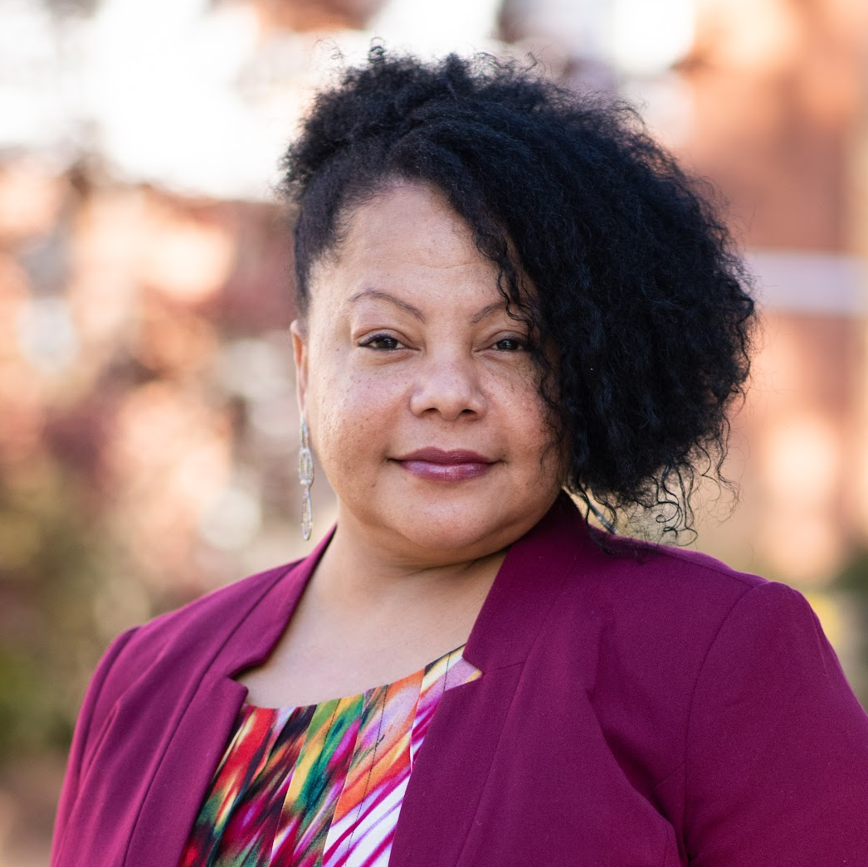
Thank You!
Quinnley A. Coley
CHIEF FINANCIAL OFFICER
quinnleycoley@fcschools.net
(919) 496-2600 PH
(919) 496-6659 FAX
Notes:
No changes

