Slide 1
Franklin County Schools
SUMMER LEARNING OPPORTUNITIES
June-August 2025

Slide 2
Summer Learning Requirements
For Summer 2025, North Carolina school districts are only required and funded to provide support to 2nd and 3rd grade students through the Read to Achieve legislation (focus on reading, 72 contact hours). All other summer learning opportunities are left to district discretion.
Given the continued need to support students who have demonstrated knowledge/skills gaps, Franklin County Schools will provide summer camp opportunities for students in grades 2-3, Rising 5th graders, 6-8, and high school. We are ready to expand service to 1st grade should the RTA allotment support it.

Slide 3
Elementary Summer Learning Opportunity
Identified students in grades 2 and 3 will receive support in Reading. Read to Achieve legislation requires support be offered to students in these grade levels and students must receive at least 72 hours of support.
Targeted RTA Rising 5th graders will be invited to participate in a “Prep Academy” designed to foster transition from 4th to 5th grades through Hands-On learning extension activities.
  SL Site: Louisburg Elementary
Support for 1st grade is contingent on funding and space. State funding for required Read to Achieve camp is limited and will be used to support as many students as possible. There are no remaining ESSER funds to supplement camp costs in Summer 2025.

Slide 4
Middle School Summer Learning Opportunity
6 Career Camps
Art Camp (Funded through NC Arts Council)
Middle school students will also have the opportunity to participate in CTE career and art camps held at our traditional high schools during the last week of June. Students in 8th grade will also have the opportunity to participate in District C Teamship.

Slide 5
High School Summer Learning Opportunity
Identified high school students will work to recover credits missed during the 2024-2025 school year. The goal is for students to remain on-track to graduate with their 9th grade cohort.
District C Teamship will be offered to interested students in grades 8-12.
SL Site: Each traditional high school; District C Teamship--Louisburg College

Slide 6
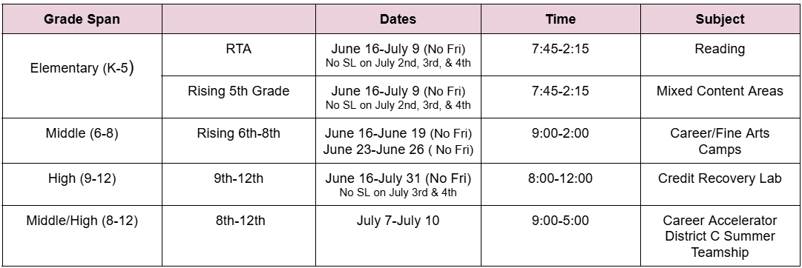
**Meals/snacks will be provide to students for all opportunities. Transportation will be provided to all students EXCEPT those participating in CTE Career and Art Camps and Career Accelerator/District C*

Slide 7
Summer Learning Staffing
FCS employees have received a survey where they can indicate interest and availability to serve during the 2025 Summer Learning needs.
Compensation (Previously Board Approved):
  Teachers will receive an hourly rate of $31 per hour.
  Teacher assistants will receive an hourly rate of $21 per hour.
  Bus driver/child nutrition staff will receive an hourly rate of $17.76 per hour.
  Some staff may receive an additional signing or performance bonus per NC legislation.

Slide 8
Summer Learning Staff Bonuses (Read to Achieve Camps only)
Signing Bonus
A one time $1,200 signing bonus (Per NC SL 2021-8 Section 7.(b)) will be paid to any teacher that
meets all of the following criteria:
Is associated with high growth in reading based on EVAAS data;
Was awarded a reading performance bonus administered by the Department of Public Instruction; and
Accepts employment to provide instruction during a reading camp.
Any signing bonus provided is not subject to retirement.
Performance Bonus
A one time $150 performance bonus will be paid (Per NC SL 2021-8 Section 7.(b)), to a teacher who provided instruction at a third grade reading camp for each student not demonstrating reading proficiency assigned to that teacher who demonstrated reading proficiency on an alternative assessment at the end of the reading camp.
Any performance bonuses provided are not subject to retirement.

Slide 9
THANK YOU!
Do you have any questions?

Slide 10
Summer Remediation Plan, 2025
On Wednesday, April 2, the Department of Public Instruction issued a memo stating that districts can now provide remediation/retesting opportunities both before and after the end of the school year.
In anticipation of the memo, meetings were held with school principals to discuss the implications of remediation/retesting prior to the end of the school year. Elementary and middle school principals wish to provide a remediation/retesting opportunity to students before June 10 (June 13 for YES). High school principals prefer to leave remediation/retesting until after school dismisses. With a shortened testing window, 5 days vs 10 days for ES and MS, coupled with a delay English II scores, testing prior to the end of the school year almost impossible.

Slide 11
Amended
Summer Remediation Plan, 2024-2025
Request:
Approval of the amended summer remediation plan for the 2024-2025 school year.

