Slide 1

Franklin CARES
September 2023
Notes:
Schuhler intro

Slide 2
Franklin CARES Overview
Franklin CARES is partnership between Franklin County Schools and our community to support reading development. CARES - Community Advancing Reading in Elementary Schools launched in March 2023 at 3 FCS elementary schools (Bunn ES, Royal ES, and Franklinton ES).

Slide 3
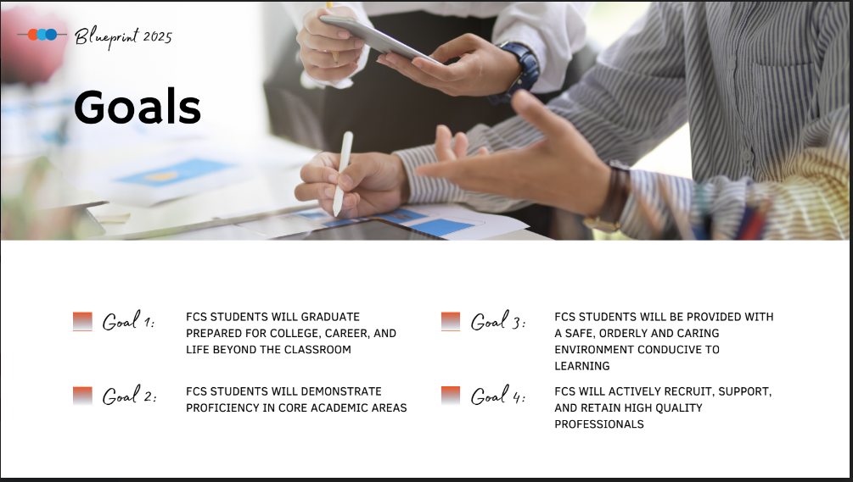

Slide 4
Franklin CARES: Our Vision
Community Advancing Reading in Elementary Schools
As a district, we believe in the power of one individual to make a positive difference in the lives of our students. The Franklin CARES initiative builds on the "Power of One" concept by engaging individual community members to support our collective efforts to help our students become better readers.

Slide 5
Franklin CARES: What is required?
Completion of basic interest form.
Completion of FCS volunteer form and approval to volunteer.
Attendance at a 1-hour training session.
Commitment to 1-hour minimum per week to read with kindergarten and first grade students who are in need of additional support and encouragement.

Slide 6
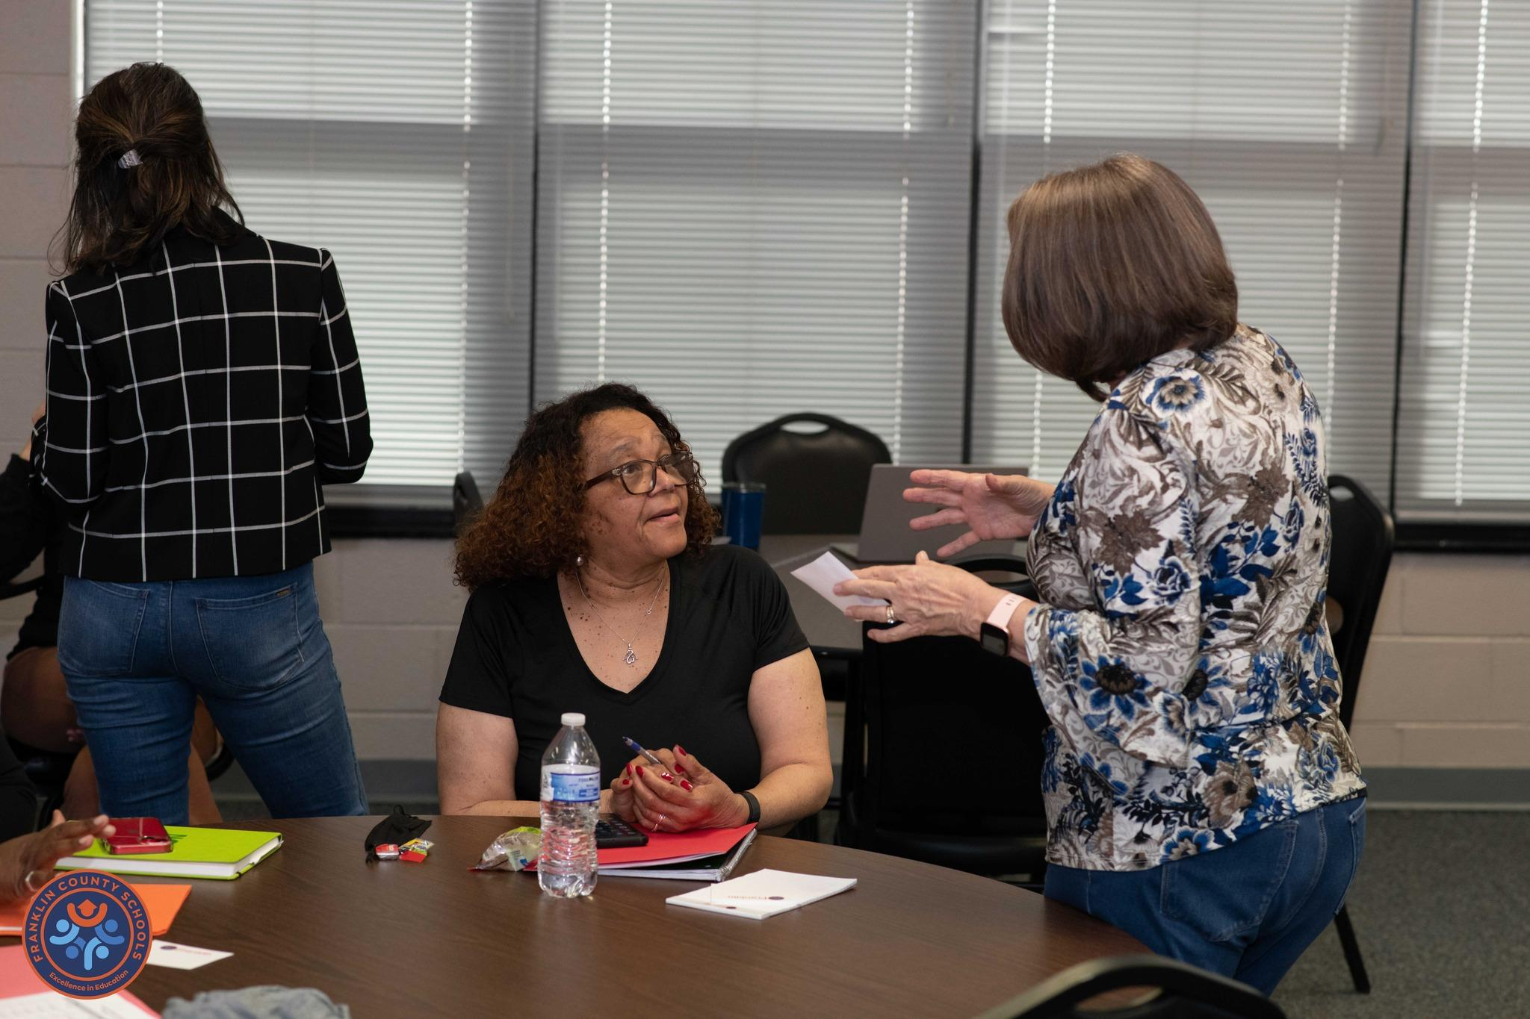
Orientation Overview
Introductions
Review the purpose and vision of Franklin CARES
Icebreaker-What is your favorite book and why?
Review guidance from Human Resources (background checks, FCS Policy 5015 School Volunteers, FCS Policy 5020 Visitors to the Schools
Discuss strategies for building relationships with students
Model an effective volunteer session

Slide 7
Franklin CARES School Procedures
For each school visit, your first stop is the school’s office. You will be asked to sign in and given a badge that must be worn at all times while inside the school building. The processes for book selection and location for the tutoring session will vary by school. Each school will provide you with directions at your first scheduled tutoring session.
Casual dress is appropriate for your time in the school.
Please check with the building principal before providing any incentives to the students. (stickers, pencils, etc.)
Please do not take pictures of students and post to your social media. However, feel free to share any pictures the school/district post to social media.
The building principal will be your first point of contact.

Slide 8

Books to Support Franklin CARES
Each school received approximately 100 books (both fiction and non-fiction) that were appropriate for our youngest students.

Slide 9
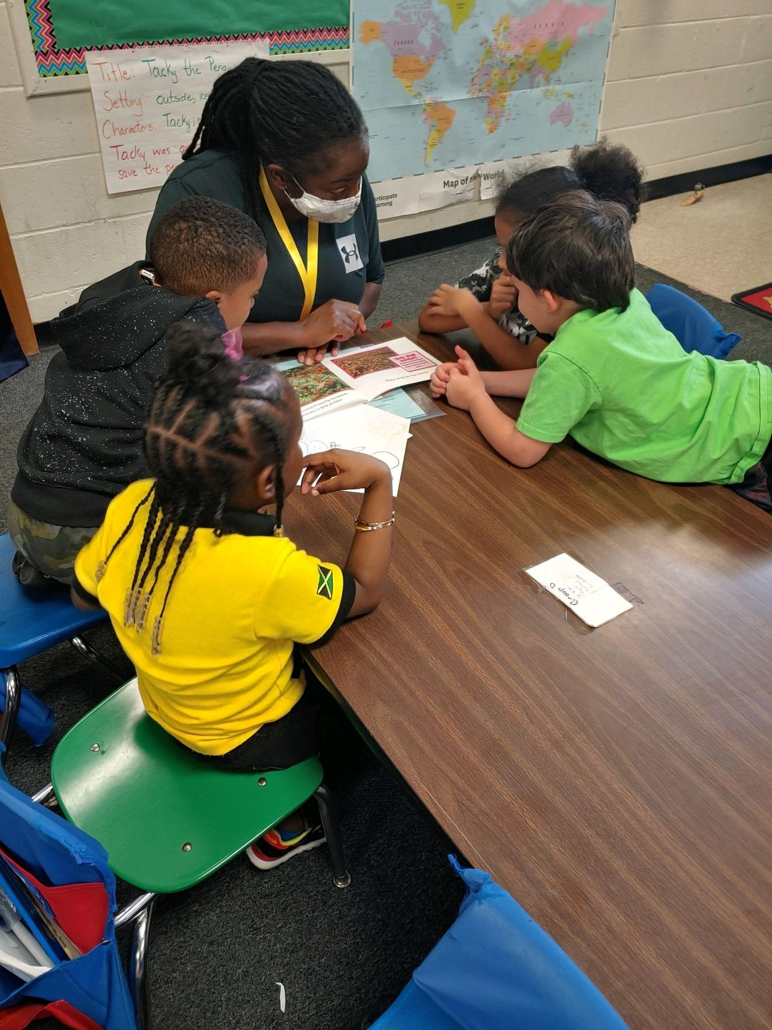
Results from Initial Program Launch
32 volunteers and 135 students participated in Spring 2023.
At the conclusion of the Spring launch, each student received a book to take home.

Slide 10
Feedback from Franklin CARES Volunteers
“I believe the most positive takeaway I can share is this program is an opportunity for the children who are involved to meet and interact with adults who care and show kindness for them outside of their regular, daily circles. I can't speak for the children, but I know it is fun for me, and I can only hope it is for them as well.”
“I'm so excited to be able to volunteer and share some time with the students; they are definitely happy to have that special time and I do hope others will volunteer. This is a much needed program and I look forward to continuing this in the next school year.”

Slide 11
Franklin CARES will begin at all 8 FCS elementary schools in Fall 2023. Interest forms are now available and volunteer orientation sessions will take place in the next couple of weeks.

Slide 12

24
Questions?

